Slide 1

Objectives
In this session, you will learn to:
  Define events and event handling
  Determine the user action that originated the event from the event object details
  Identify the appropriate listener interface for a variety of event types
  Create the appropriate event handler methods for a variety of event types
  Understand the use of inner classes and anonymous classes in event handling
  Identify the key AWT components and the events they trigger
  Describe how to create menu, menu bar, menu items and how to control visual aspects

Slide 2
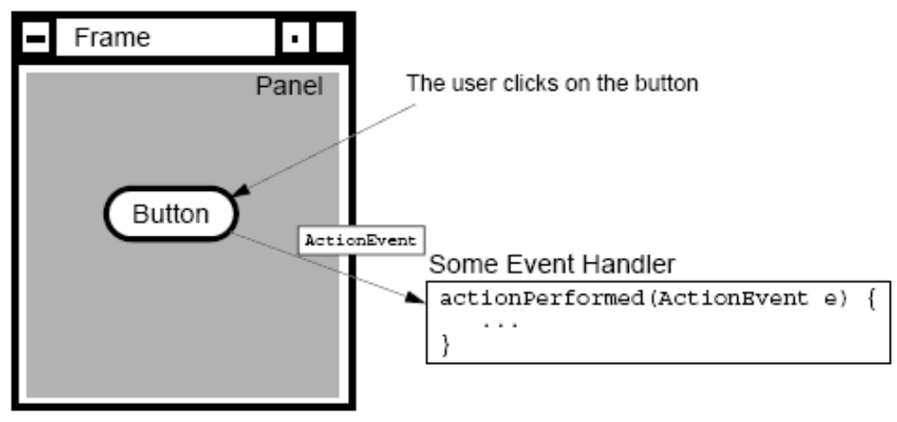
Events
Events: Objects that describe what happened
Event sources: The generator of an event
Event handlers: A method that receives an event object, deciphers it, and processes the user’s interaction.

Slide 3
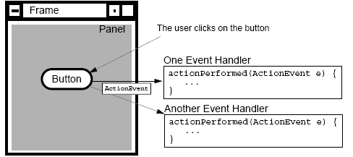
Delegation Model of Event
An event can be sent to many event handlers.
Event handlers register with components when they are interested in events generated by that component.

Slide 4
Delegation Model of Event (Contd.)
Client objects (handlers) register with a GUI component that they want to observe.
GUI components only trigger the handlers for the type of event that has occurred.
Most components can trigger more than one type of event.
The delegation model distributes the work among multiple classes.

Slide 5
A Listener Example
This code snippet shows a simple Frame with a single button on it, class name is TestButton:
  public TestButton()
  {
    f = new Frame("Test");
    b = new Button("Press Me!");
    b.setActionCommand("ButtonPressed");
  }
  public void launchFrame()
  {
    b.addActionListener(new ButtonHandler());
    f.add(b,BorderLayout.CENTER);
    f.pack();
    f.setVisible(true);
  }

Slide 6
A Listener Example (Contd.)
Code for the event listener looks like this:
  import java.awt.event.*;
  public class ButtonHandler implements ActionListener
  {
    public void actionPerformed(ActionEvent e)
    {
      System.out.println("Action occurred");
      System.out.println("Button’s command is: "+ e.getActionCommand());
    }
  }
The event is delegated to ButtonHandler class.

Slide 7
Demonstration
Lets see how to use the Event handling API to handle simple GUI events.

Slide 8
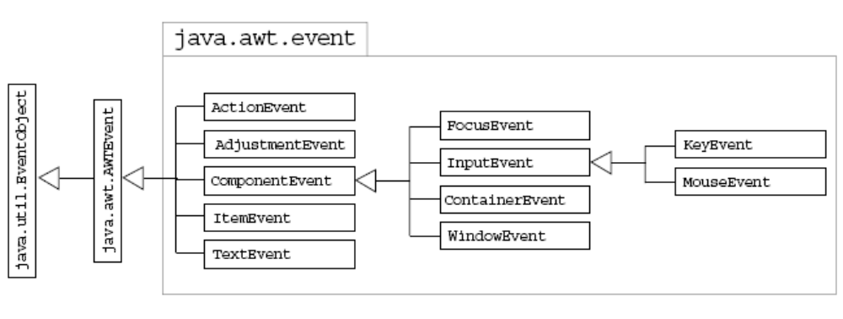
Event Categories
Class Hierarchy of GUI Events:

Slide 9
Listener Type
Some Events and Their Associated Event Listeners:
Act that Results in the Event | Listener Type
User clicks a button, presses Enter while typing in a text field, or chooses a menu item | ActionListener
User closes a frame (main window) | WindowListener
User presses a mouse button while the cursor is over a component | MouseListener
User moves the mouse over a component | MouseMotionListener
Component becomes visible | ComponentListener
Component gets the keyboard focus | FocusListener

Slide 10

Listeners
ActionListener Interface:
  Has only one method i.e. actionPerformed(ActionEvent)
  To detect when the user clicks an onscreen button (or does the keyboard equivalent), a program must have an object that implements the ActionListener interface.
  The program must register this object as an action listener on the button (the event source), using the addActionListener() method.
  When the user clicks the onscreen button, the button fires an action event.

Slide 11
Listeners (Contd.)
MouseListener interface:
  To detect the mouse clicking, a program must have an object that implements the MouseListener interface.
  This interface includes several events including mouseEntered, mouseExited, mousePressed, mouseReleased, and mouseClicked.
  When the user clicks the onscreen button, the button fires an action event.

Slide 12
Listeners (Contd.)
Implementing Multiple Interfaces:
  A class can be declared with Multiple Interfaces by using comma separation:
    Implements MouseListener,MouseMotionListener
Listening to Multiple Sources:
  Multiple listeners cause unrelated parts of a program to react to the same event.
  The handlers of all registered listeners are called when the event occurs.

Slide 13
Event Adapters
The listener classes that you define can extend adapter classes and override only the methods that you need.
An example is:
  import java.awt.*;
  import java.awt.event.*;
  public class MouseClickHandler extends MouseAdapter
  {
    //We just need the mouseClick handler, so //we use an adapter to avoid having to //write all the event handler methods

Slide 14
Event Adapters (Contd.)
    public void mouseClicked(MouseEvent e)
    {
    // Do stuff with the mouse click...
    }
  }

Slide 15
Inner Classes
Event Handling Using Inner Classes:
  Using inner classes for event handles gives access to the private data of the outer class.

Slide 16
MenuBar
Frames can contain a menu bar, a menu bar can contain zero or more menus, and menu can contain zero or more menu items (including submenus).
Let’s see how to do this.

Slide 17
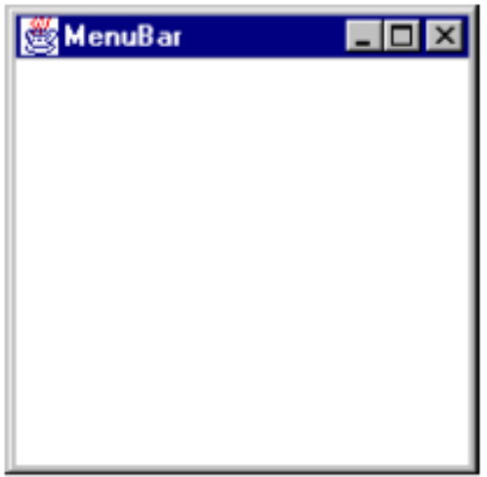
Creating a MenuBar
Create a MenuBar object, and set it into a menu container, such as a Frame. For example:
  Frame f = new Frame("MenuBar");
  MenuBar mb = new MenuBar();
  f.setMenuBar(mb);

Slide 18
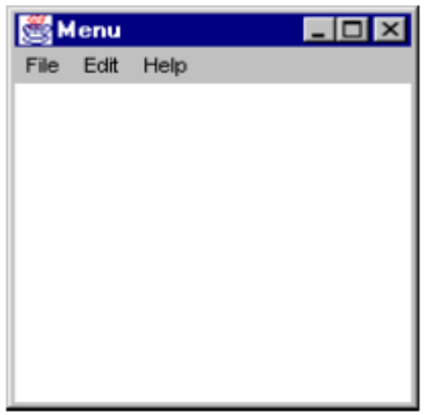
Creating a Menu
Create one or more Menu objects, and add them to the menu bar object. For example:
  Frame f = new Frame("Menu");
  MenuBar mb = new MenuBar();
  Menu m1 = new Menu("File");
  Menu m2 = new Menu("Edit");
  Menu m3 = new Menu("Help");
  mb.add(m1);
  mb.add(m2);
  mb.setHelpMenu(m3);
  f.setMenuBar(mb);

Slide 19
Creating a MenuItem
Create one or more MenuItem objects, and add them to the menu object. For example:
  MenuItem mi1 = new MenuItem("New");
  MenuItem mi2 = new MenuItem("Save");
  MenuItem mi3 = new MenuItem("Load");
  MenuItem mi4 = new MenuItem("Quit");
  mi1.addActionListener(this);
  mi2.addActionListener(this);
  mi3.addActionListener(this);
  mi4.addActionListener(this);
  m1.add(mi1);
  m1.add(mi2);

Slide 20
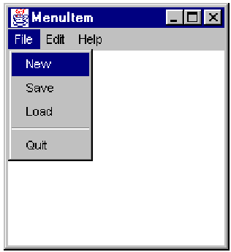
Creating a MenuItem (Contd.)
  m1.add(mi3);
  m1.addSeparator();
  m1.add(mi4);
Let’ see how MenuItem will look like.

Slide 21
Demonstration
Lets see how to add a menu and other GUI components to a AWT application.

Slide 22
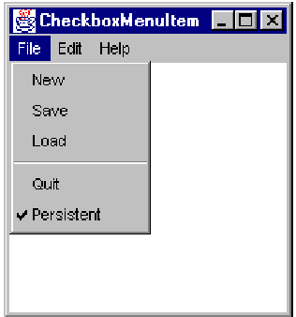
Creating a CheckBoxMenuItem
Creating a CheckBoxMenuItem:
  CheckboxMenuItem mi5 = newCheckboxMenuItem("Persistent");
  mi5.addItemListener(this);
  m1.add(mi5);

Slide 23
Controlling Visual Aspects
Commands to control visual aspects of the GUI include:
  Colors:
    setForeground()
    setBackground()
  Example:
    Color purple = new Color(255, 0, 255);
    Button b = new Button(“Purple”);
    b.setBackground(purple);

Slide 24
J.F.C./Swing Technology
Java Foundation Class/Swing (J.F.C./Swing) technology is a second-generation GUI toolkit.
It builds on top of AWT, but supplants the components with lightweight versions.
There are many more components, and much more complex components, including JTable, JTree, and JComboBox.

Slide 25
Summary
In this session, you learned that:
  When user perform some action, for example, button click or mouse move then the program performs some action which is called event.
  Events can be handled by implementing appropriate Listener Interface.
  Most components can trigger more than one type of event.
  The delegation model distributes the work among multiple classes.
  ActionListener Interface:
    When the user clicks an onscreen button (or does the keyboard equivalent), a program must have an object that implements the ActionListener interface.
  MouseListener Interface:
    To detect the mouse clicking, a program must have an object that implements the MouseListener interface.

Slide 26
Summary (Contd.)
  A class can be declared with multiple interfaces by using comma separation.
  Event Adapter classes can be used in place of implementing listener, if you need to implement only one method.
  Manubar can be created by creating a MenuBar class object, and set it into a menu container, such as a Frame.
  Menu class object is used to create menu, and add them to the MenuBar object.
  MenuItems can be created by creating one or more MenuItem class objects, and add them to the menu object.
  Checked menuitems can be created by using CheckboxMenuItem class object.
  Colors can be set by creating the Color class object.

